Slide 1
Community Planning Outcomes Profile
Nick Cassidy – Research Manager
Cara Connachan – Senior Research Officer
The ‘go to’ organisation for Local Government improvement in Scotland
Notes:
Purpose – overview, refresher, and examples of how it could be used. Hear your thoughts

Slide 2
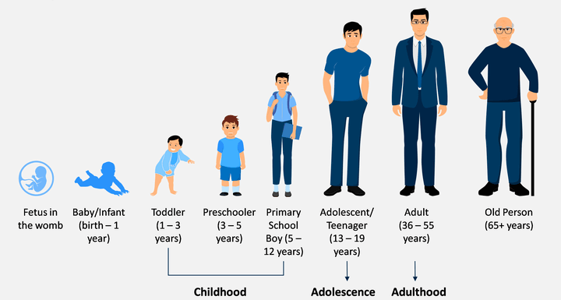
What is the profile?
A tool to help you assess if the lives of people in your community are improving
A set of core measures on important life outcomes including early years, older people, safer/stronger communities, health and wellbeing, and engagement with local communities
A consistent basis for measuring outcomes and inequalities of outcome in your area
An analysis tool
The ‘go to’ organisation for Local Government improvement in Scotland
Notes:
-Core measures cover whole life cycle and all communities and community groups
-A consistent data set
-Does a lot of advanced analysis for you

Slide 3
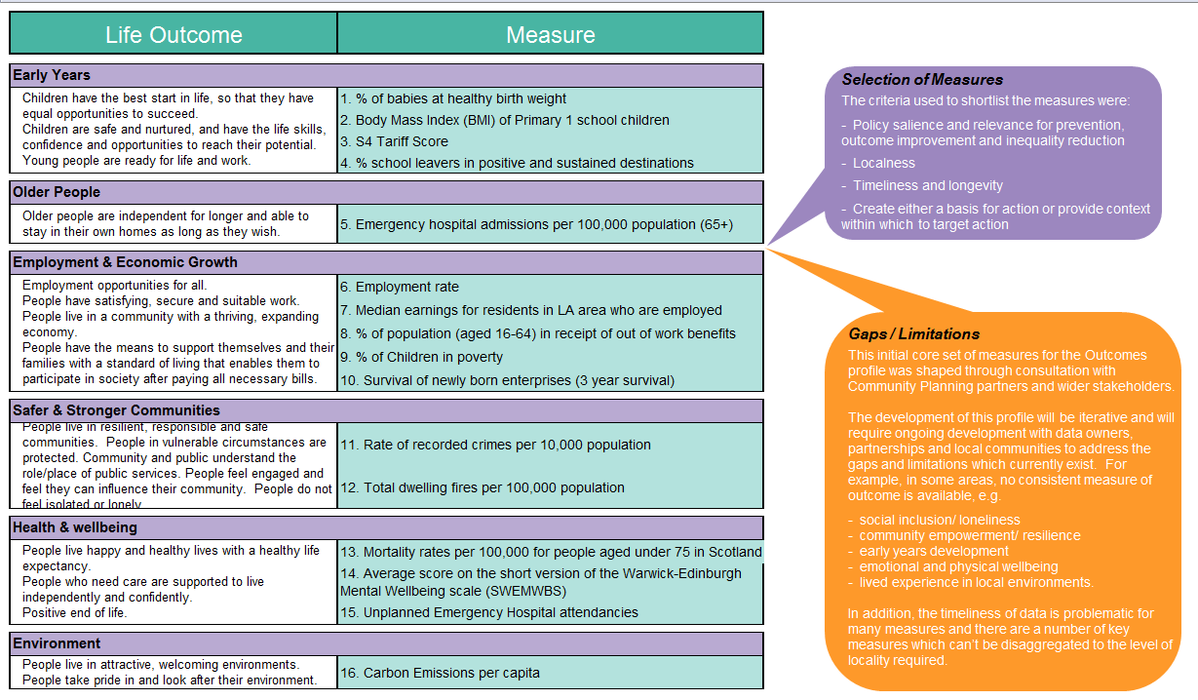
Notes:
Idea is to cover the whole life course and range of outcomes.
Measures were developed with CP Partners – criteria for inclusion
This is the original set and have been amended over the years – we know there are gaps inc. data lag.
As much as possible cover small areas, not just full CPP

Slide 4

What does the profile tell you?
At a glance and in-depth analysis on:
The overall pattern of outcomes in your area and whether people's lives are improving
Whether inequality is increasing or decreasing over time
Which communities are faring well or not well for your areas and for similar communities across Scotland
Identify similar areas elsewhere in Scotland, creating opportunities for learning
The ‘go to’ organisation for Local Government improvement in Scotland
Notes:
Both at a glance information and in depth analysis
Focus on change over time
Good/bad performance
Uniquely we have the comparison with similar areas – about learning from others.

Slide 5
How can the profile be used?
To support decision-making by:
Stimulating discussion amongst CP boards, partners and local communities
Increasing the amount of intelligence available about an area
Complementing professional judgement and local knowledge
Inform the development of Local Outcomes Improvement Plans
The ‘go to’ organisation for Local Government improvement in Scotland

Slide 6





How is this approach different?
Focus: CPPs
It brings together measures of outcomes and inequality for all 32 CPPs within one profile - and shows how they change over time
It considers outcomes 'in the round' as well as individually, encouraging a focus on vulnerable communities where negative outcomes are clustered
It enables partnerships to compare outcomes for their local communities against similar communities across Scotland
The ‘go to’ organisation for Local Government improvement in Scotland
Notes:
Lots of other data sources and tools
CPOP is focused on community planning partnerships and what they need
-Selecting, cleaning, presenting key data
-Change over time – measure improvement – including into the future
-Holistic approach (understand performance across multiple indicators), but allows focus on specific areas
-Typology – income, rurality, population groups

Slide 7
CPOP Demo
The ‘go to’ organisation for Local Government improvement in Scotland
Notes:
The CPOP has a range of data both at a CPP level and at a more granular intermediate geography zone and data zone level. One of the key features of the tool is the ability to make comparisons between areas, comparisons over time and to look both at outcomes and progress with these outcomes across the full range of indicators.
This demo will provide a bit of insight into how the tool can be used to understand your CPP’s performance, explore areas for improvement, and identify other local areas that you may be able to learn from.
First select your CPP area to explore the tool.

Slide 8
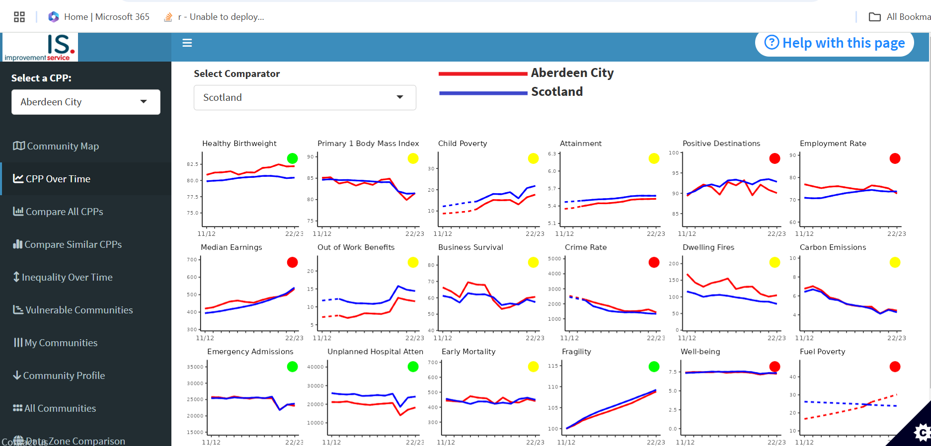
CPP Over Time
The ‘go to’ organisation for Local Government improvement in Scotland
Notes:
The CPP over time page allows you to see how your CPP has performed over time for a range of outcomes. You can see how this performance compares to the Scotland average or select a comparative CPP to compare with.
The coloured dots in the corner of each graph give an indication of how your CPP is performing compared to the comparator. Green means the CPP performed better in the most recent year and has improved at a faster rate. Red means the CPP performed poorer in the most recent year and has improved at a slower rate, whilst yellow means that one factor was better than the comparator, either performance or improvement over time.
This visual allows you to scan across and gauge the CPP’s performance over the range of outomes, ideally aiming to see mostly greens with very few reds.

Slide 9
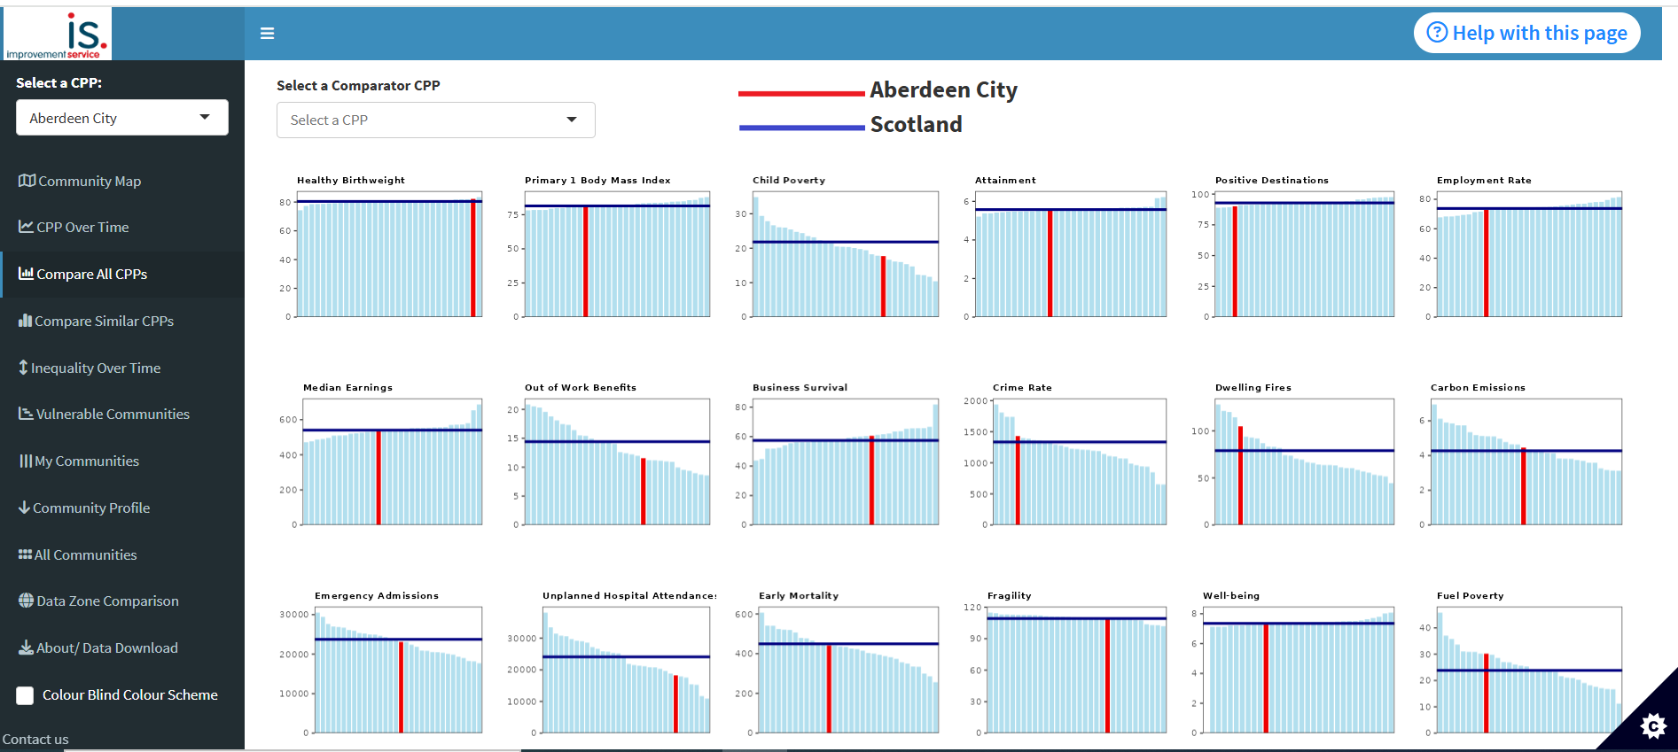
Compare all CPP’s
The ‘go to’ organisation for Local Government improvement in Scotland
Notes:
The Compare all CPP’s page allows you to see for the full range of indicators how your CPP compares with all other CPP’s in Scotland. It shows where performance for your CPP sits relative to other CPP’s as well as the Scotland average. There is also an option to select a CPP to compare which will highlight this comparators relative position.
This page provides another useful tool for gauging relative performance across the full range of outcomes. All the graphs are ordered with the best performing CPP’s at the left-hand side at the poorer performing CPP’s at the right-hand side. Therefore, it can be used to visualise if your CPP has more outcomes with relatively good performance or relatively poor performance.

Slide 10
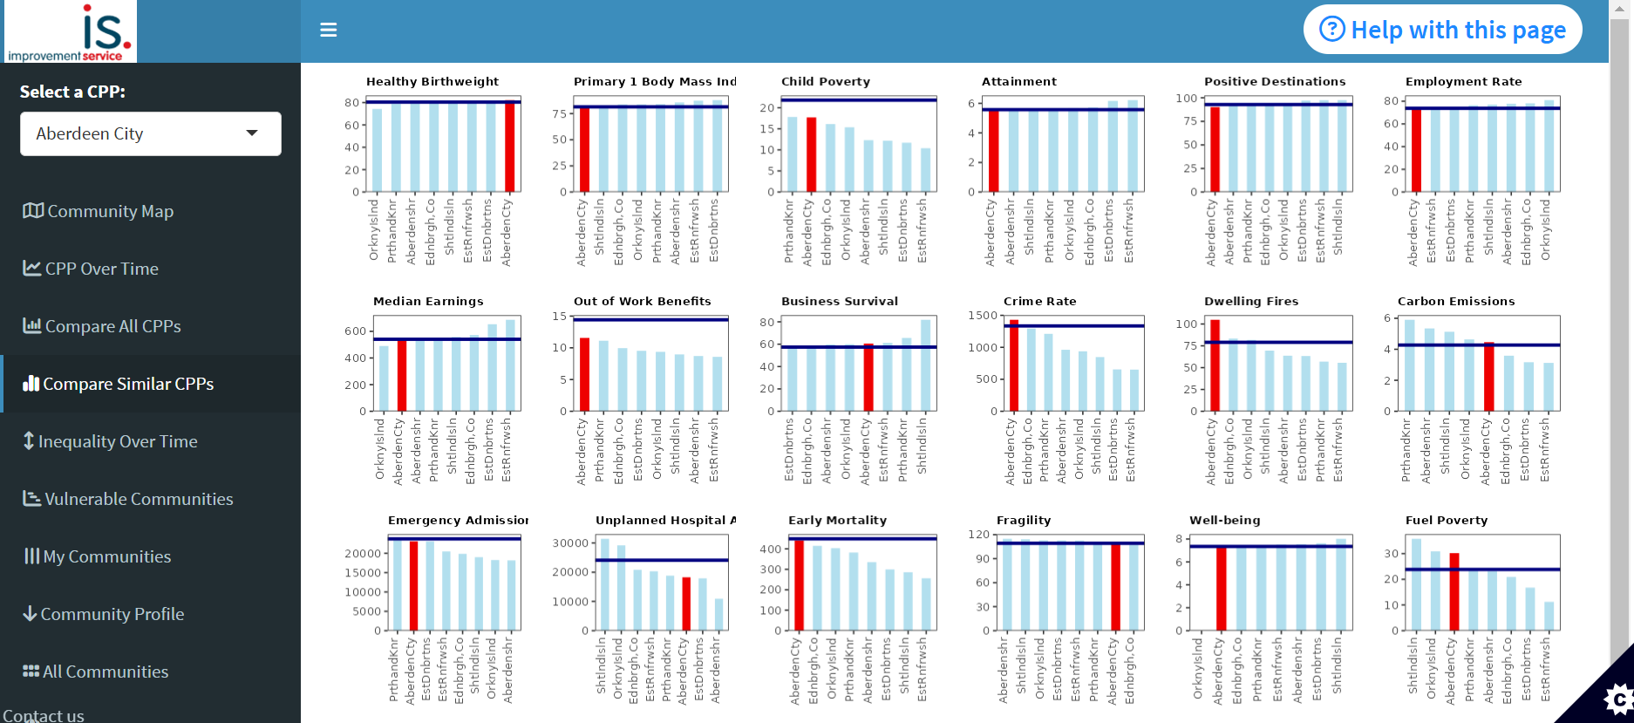
Compare Similar CPP’s
The ‘go to’ organisation for Local Government improvement in Scotland
Notes:
The Compare Similar CPP’s page works on the same principles as the previous page however is shows your CPP’s performance relative to other similar CPP’s rather than all CPP’s.
These similar CPP’s are defined as CPP’s with similar levels of deprivation.
This allows you to see your relative performance to those areas that are most likely to experience similar challenges to your own.
All three of these pages provide a good starting point for understanding how your CPP as a whole is performing and identify specific outcomes that are performing well or more poorly.

Slide 11
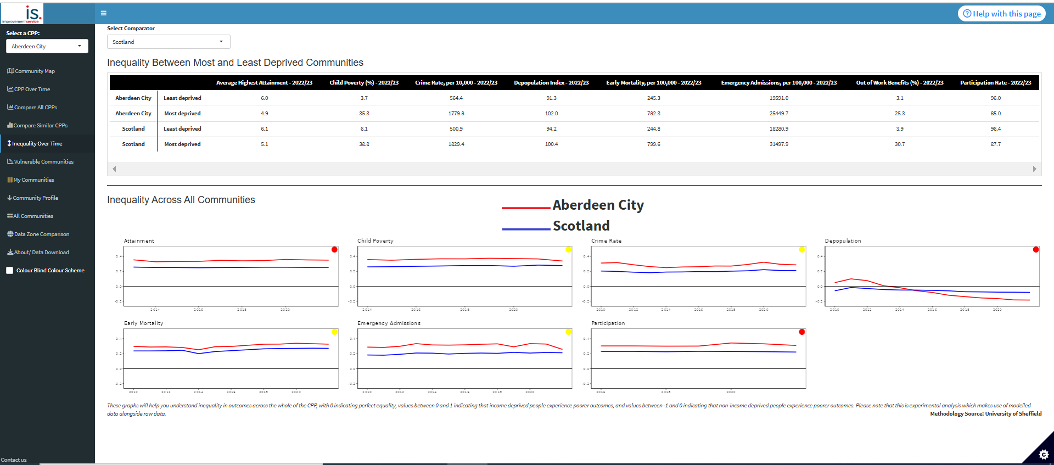
Inequality Over Time
The ‘go to’ organisation for Local Government improvement in Scotland
Notes:
The next two pages focus on inequality within the CPP and how this is changing.
The Inequality Over Time page explores inequality across communities within your CPP. The table shows across a range of outcomes the most recent value for the most deprived community in your CPP and the least deprived community in your CPP. It shows a comparison with Scotland, or another CPP of your choosing. This enables you to see the gap between outcomes for your most and least deprived communities and see whether this gap is smaller or wider than across Scotland. It also allows you to see for which outcomes the gap is widest.
Below this table is a series of graphs showing how inequality looks across all communities within the CPP. The analysis creates an index of inequality with a value of 0 in the middle representing perfect equality. Values above this line represent where income deprived communities experience poorer outcomes and values below this line represent where income deprived communities experience better outcomes. These graph show how inequality across communities in your CPP relative to Scotland or another comparator. Again, the dots are used to visualise how both performance in the most recent year and performance over time compares.
These are useful visuals for understanding the depth of inequality across different outcomes, how this compares to elsewhere and how this is changing over time. Ideally a CPP would be looking to have outcomes sitting close to the middle line and more green dots than red dots.

Slide 12
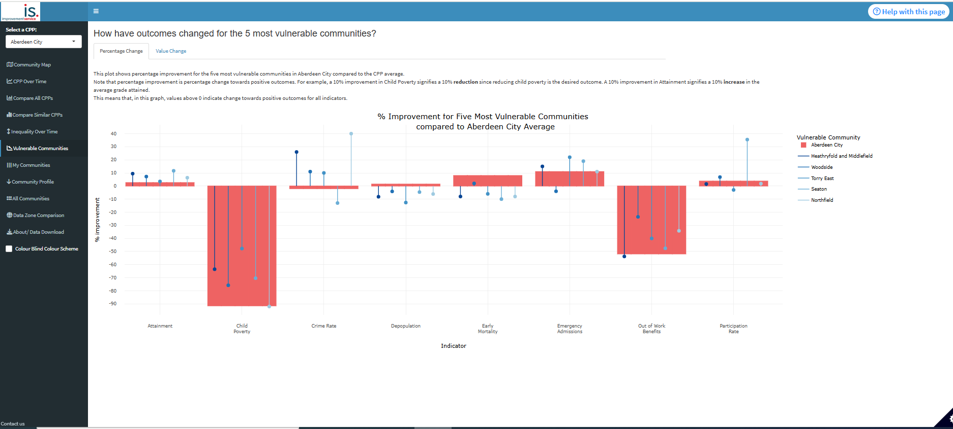
Vulnerable Communities – Percentage Change
The ‘go to’ organisation for Local Government improvement in Scotland
Notes:
The Vulnerable Communities page focuses on how outcomes for the most vulnerable communities within the CPP are changing.
In the percentage change tab, for each outcome the rate of improvement is plotted for the 5 most vulnerable communities within the CPP compared with the CPP average.
Ideally, we’re looking to see improvement in outcomes so want as many outcomes to show positive values. It’s also useful to understand how the rate of improvement compared between the most vulnerable communities and the CPP average. If the CPP average shows a greater rate of improvement then this means the inequality in outcomes is getting wider.

Slide 13
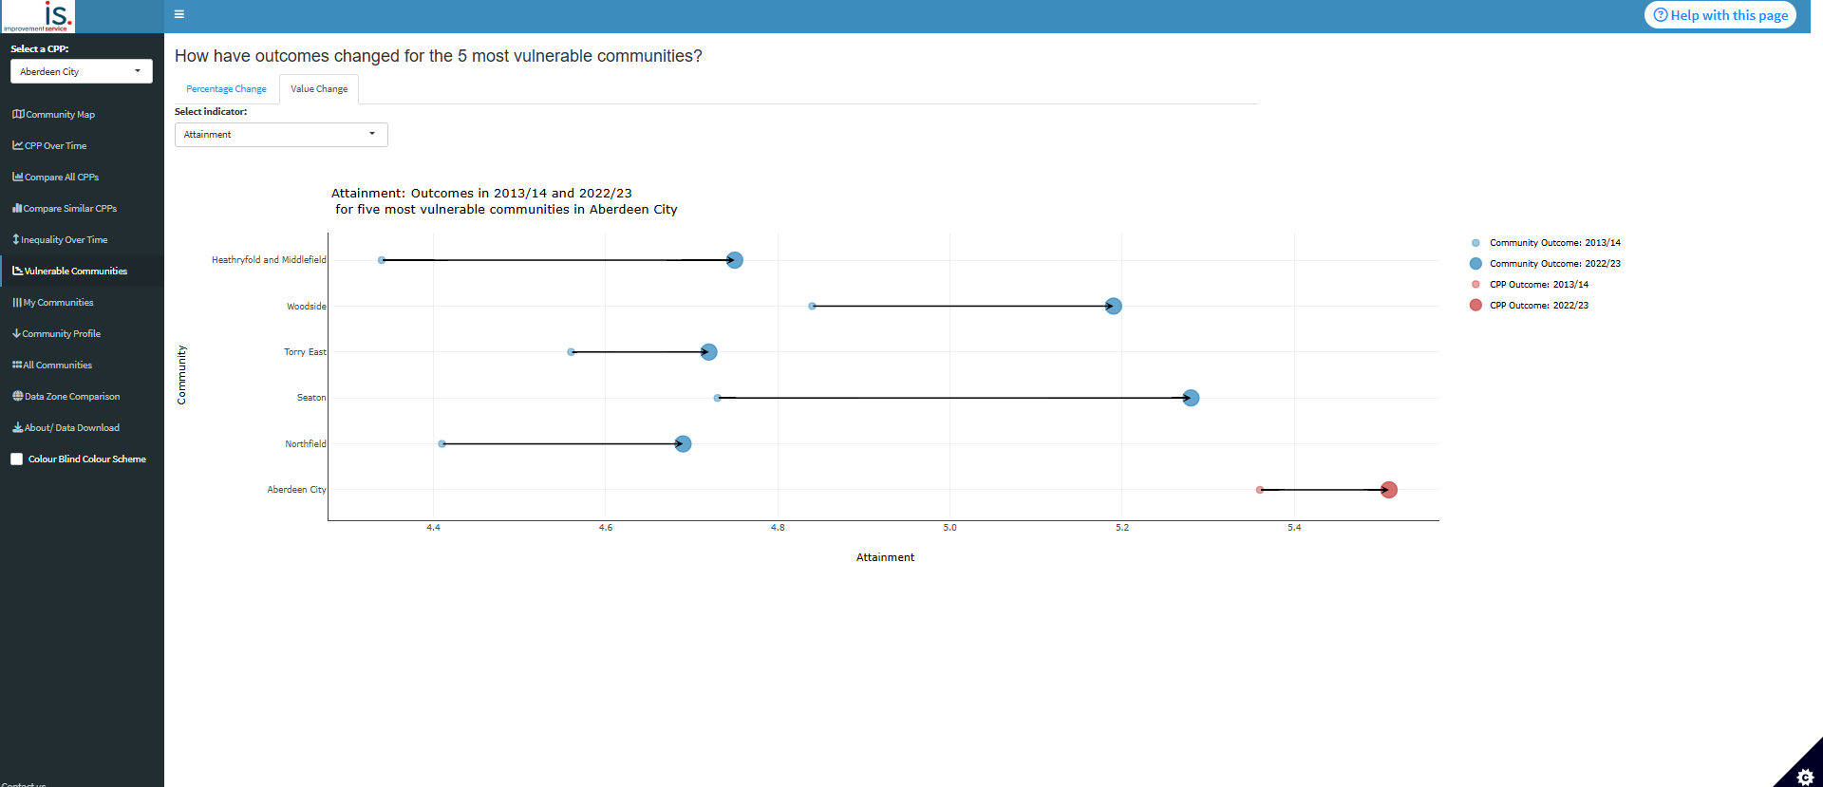
Vulnerable Communities – Value Change
The ‘go to’ organisation for Local Government improvement in Scotland
Notes:
In the Value change tab, the same 5 most vulnerable communities are plotted against the CPP average. The graph shows one indicator at a time, which can be selected using the drop down, and shows the value has changed from the base year to the most recent year for each of these communities.
This is useful for highlighting the scale of improvement for vulnerable communities and the progress they are making relative to the CPP average.

Slide 14
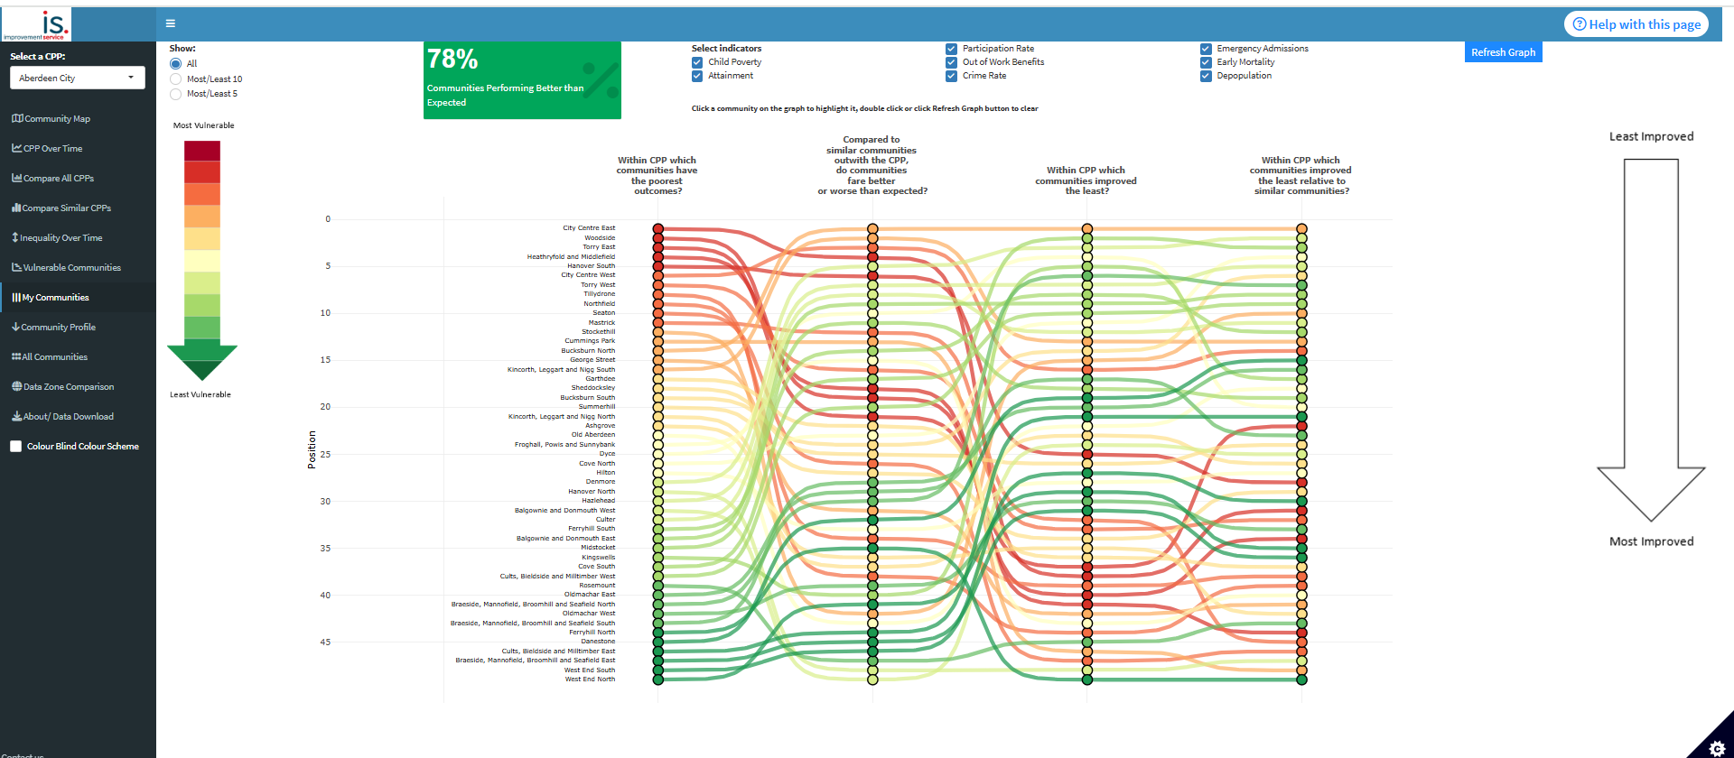
My Communities
The ‘go to’ organisation for Local Government improvement in Scotland
Notes:
The next two pages focus on how all communities within the CPP are performing and how this compares to other communities in Scotland similar to these.
The My Communities page has a visualisation of performance and improvement across the CPP. In the first column of this visualisation the communities within the CPP are ranked from those with the poorest outcomes to those with the best outcomes, when compared with the CPP average. This rank is a combined score of all the outcomes, but the outcomes included in this analysis can be selected and unselected at the top of the page.
The remaining columns track the initial rankings of these communities by different criteria.
The second column ranks communities within the CPP by outcomes in comparison to outcomes in other similar communities in Scotland. These similar communities are defined by demographic, income and rurality.
The third column ranks communities by how much outcomes have improved compared to the CPP average, and the last column ranks communities by how much outcomes have improved compared to similar communities.
This allows us to see how communities are performing, how they are improving and how they compare both to the average of communities within the CPP and similar communities outwith the CPP.
Looking at communities with the poorest outcomes in the first column, we would hope that they may have better outcomes when compare to similar CPP’s and would also be hoping to see that they are improving at a faster rate than the CPP average and other similar communities.
The box at the top gives a quick overview of what percentage of communities within the CPP are performing better than expected, when compared with other similar communities.

Slide 15
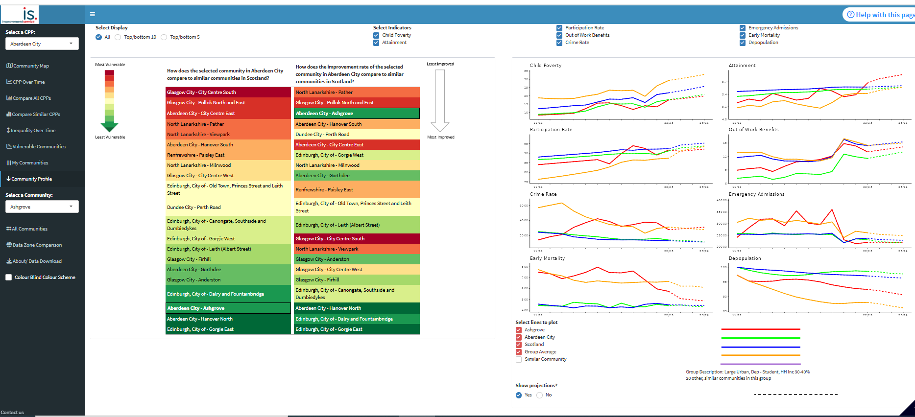
Community Profile
The ‘go to’ organisation for Local Government improvement in Scotland
Notes:
The Community Profile page follows a similar premise as the previous tab with ranking communities and tracking how this changes for different criteria.
In the first column of the visualisation, a selected community within your CPP is ranked against similar communities in Scotland based on outcome performance. The selected community can be changed as well as the outcomes included in the analysis.
In the second column, the selected community is then ranked against similar communities based on how outcomes have improved over time.
This analysis is useful for examining individual communities more closely to understand performance relative to comparative areas and potentially identify areas with similar features which may have better performance and therefore may have learning to share.
The graphs on the page also allow us to see these changes over time for the selected community and selected comparators.

Slide 16
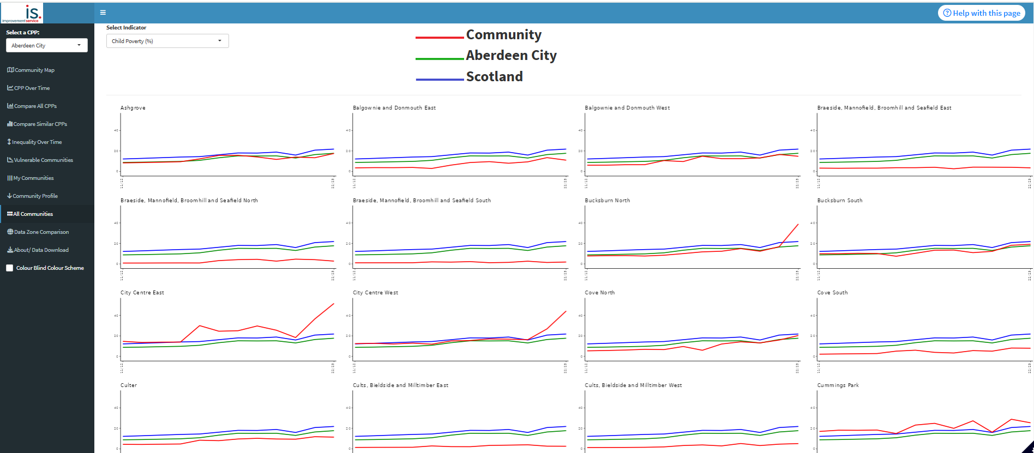
All Communities
The ‘go to’ organisation for Local Government improvement in Scotland
Notes:
The All Communities page shows individual graphs for each community within the CPP. The graph shows performance over time for one of the selected outcomes and shows how the communities performance compares to the overall CPP performance as well as performance across Scotland.
This is useful for visualising how performance is changing over time across communities and identifying specific communities that vary.

Slide 17
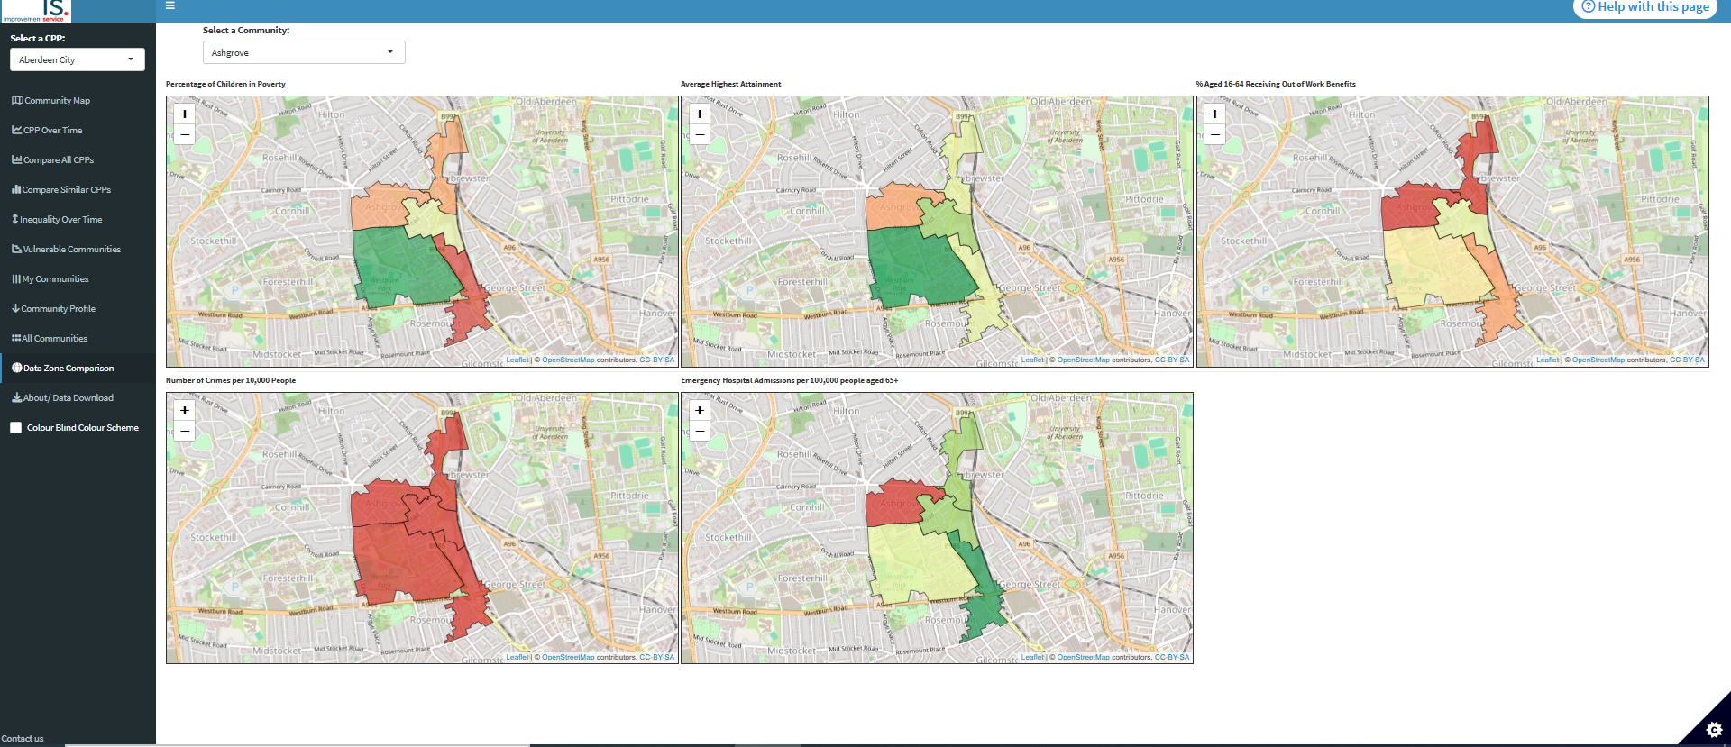
Data Zone Comparison
The ‘go to’ organisation for Local Government improvement in Scotland
Notes:
Lastly, the data zone comparison page shows performance for communities broken down to a more granular data zone level.
The maps show for the selected community how performance compares across the area. The colours represent the ranking of the data zone across all data zones in the CPP. This allows you to see within communities if there are concentrated areas of poorer outcomes.

Slide 18
Case Studies
The ‘go to’ organisation for Local Government improvement in Scotland
Notes:
How and where used

Slide 19
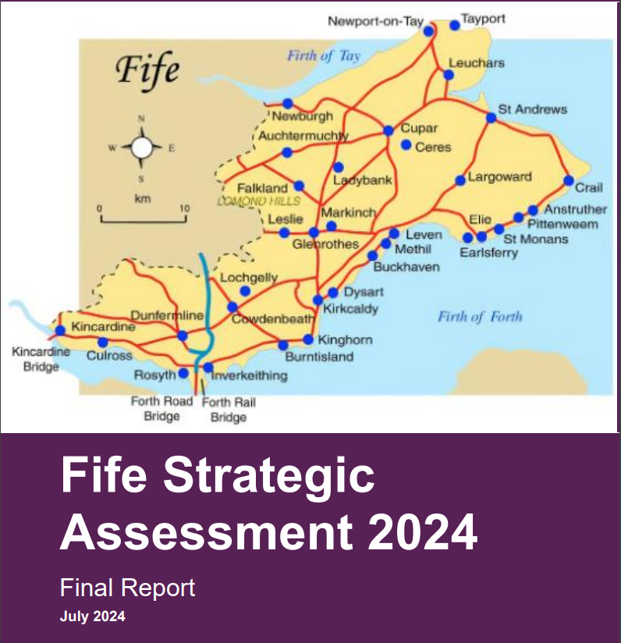
Case Studies – Fife Strategic Assessment
Fife regularly use CPOP to review and refresh their local strategic assessments
Data/analysis from CPOP
Includes comparisons with similar areas
Use the strategic assessment to identify issues and challenges facing the area
The ‘go to’ organisation for Local Government improvement in Scotland
Notes:
Use regularly for strategic assessment
Draw on data and analysis – esp. comparison with similar areas
Strat Assessments used for prioritisation

Slide 20
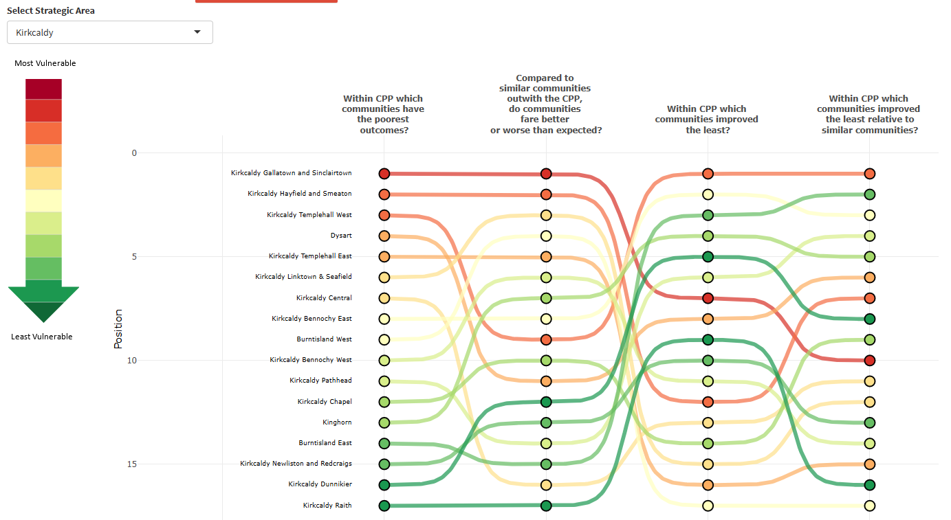
Case Studies – Fife Strategic Assessment
The ‘go to’ organisation for Local Government improvement in Scotland
Notes:
To help with his – Fife has their own custom setting in the dashboard , which allows them to compare areas within each strategic area

Slide 21
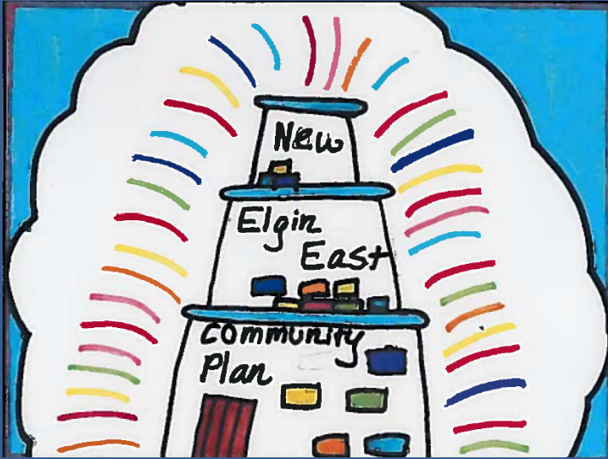
Case Studies – Moray Locality Profiling
Moray use for prioritisation
Identify two most vulnerable areas
CPOP data used together with other sources
Buckie Central East and New Elgin East
Developed Locality Plans to tackle the primary issues in each
Ongoing review – CPOP focus on time series
The ‘go to’ organisation for Local Government improvement in Scotland
Notes:
-Prioritise
-data from other sources to identify the 2 most vulnerable communities
-issues including reducing child poverty, improving educational attainment, and improving employment opportunities in better paid jobs
-Ongoing review

Slide 22
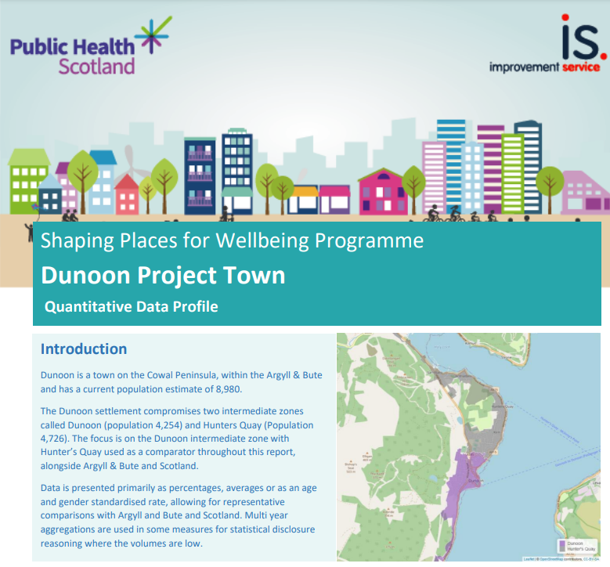
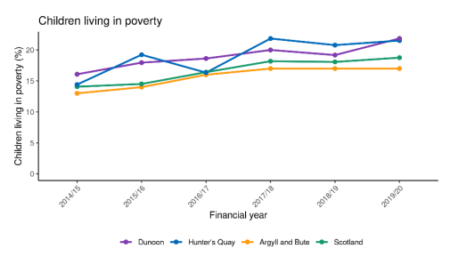
Case Studies – Shaping Places for Wellbeing
Shaping Places for Wellbeing incorporated the data and analysis into their quantitative review of towns.
The ‘go to’ organisation for Local Government improvement in Scotland
Notes:
Shaping Places for Wellbeing – national programme between PHS and IS – 7 towns to embed place based approaches
First step was quantitative profiling
Dunoon - https://www.improvementservice.org.uk/__data/assets/pdf_file/0022/48307/Shaping-Places-for-Wellbeing-Dunoon-Profile.pdf
-Useful as a good data source
-Wider cohort of PHS colleagues interested in some of the more advanced analysis

Slide 23
What do you need to know about your local area?
Were you aware of the CPOP? Have you used it?
How have you used it in the past? How could you use it in the future?
The ‘go to’ organisation for Local Government improvement in Scotland

Slide 24


What do you need to know about your local area?
ⓘ Start presenting to display the poll results on this slide.

Slide 25

Before Today Were You Aware of the CPOP?
ⓘ Start presenting to display the poll results on this slide.

Slide 26
How have you used the CPOP in the past? What could you use it for in future?
ⓘ Start presenting to display the poll results on this slide.

